Slide 1
Students can fail professionally if they:
Do not attend or are late to teaching days, practice tutorials, formation group meetings or Professional Development training without professional reasons.
Fail to submit work to their PT 48 hours before tutorials (or as agreed)
Fail to adhere to agency and/or CYM values, expectations, policies and procedures
Do not communicate professionally with or within the agency or MCYM
Demonstrate unprofessionalism regarding their attitude, reliability, honesty or integrity.

Slide 2
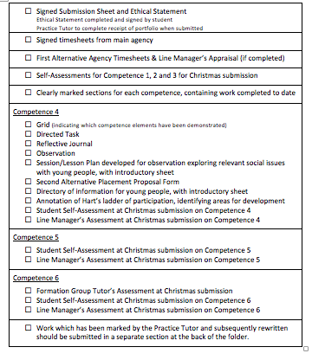

Slide 3
Competence 4: Communities and Contexts
You need to be able to demonstrate the following knowledge, skills, attitude and theological engagement in a range of situations. Relevant theory and theological reflection should be integrated throughout.
a. Understand the history, context and development of your agency and its local community (e.g. mission, goals and place in community).
b. Understand sociological and political factors that impact individuals, families and communities (e.g. prejudice, racism, social class prejudice).
c. Reflect theologically on inclusion, participation and community
d. Demonstrate an ability to work participatively with young people in communities, enabling them to be active citizens, understanding their role in their communities, communicating their perspective and developing influence over people and situations.
e. Develop and maintain appropriate strategic networks and partnerships (for example: with other local service providers, parents, families, specialist agencies)
f. Demonstrate skills necessary to undertake community research and undertaking effective consultation with young people and other stakeholders

Slide 4
Observation

Slide 5
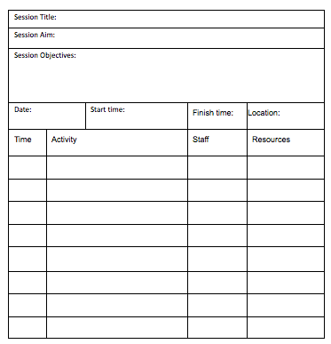
ACTIVITY
Look at the session plan – how would sessions you do fit with this?
30 minutes
Create an icebreaker activity or a reflection activity (taking up to 10 minutes) that you could do with young people for your session
Do your activity
Evaluate/reflect what could you do differently, what might you have to change

Slide 7
Student Self-Assessment at Christmas submission on Competence 4
Line Manager’s Assessment at Christmas submission on Competence 4

Slide 8
Directed Task
Complete a community research project in consultation with your agency and produce a report of your findings. This should include a summary of the community you are researching, an overview of key facts and information about it, evidence of engaging appropriately with members of the community to find out further information and recommendations for how work within the community could be developed. (Guide length 1500-2000 words)

Slide 9
Suggested structure:
• Title Page
• Contents – you should number your pages and use headings and sub-headings for clarity.
• Introduction –background, description of community, aims and objectives of report.
• Body of the Report – divided into sections and including details of findings.
• Conclusions -should follow logically, summarising key findings and issues.
• Recommendations -should lead on from findings and conclusions. They should be succinct and focused on practical suggestions for action to be taken because of the report.
• References/Bibliography
• Appendices - any technical information or documents that it would be inappropriate to include in the main body of the report. These might include a copy of a questionnaire or survey used, a summary of survey responses, any publicity material used, a list of groups/organizations contacted as part of the profile.

Slide 10
Reflective Journal
Reflect on the inclusiveness of the youth programmes within your main placement and how it embraces participation. Evaluate its strengths, weaknesses and suggest at least two improvements. (Guide length 1000-1500 words)

Slide 11
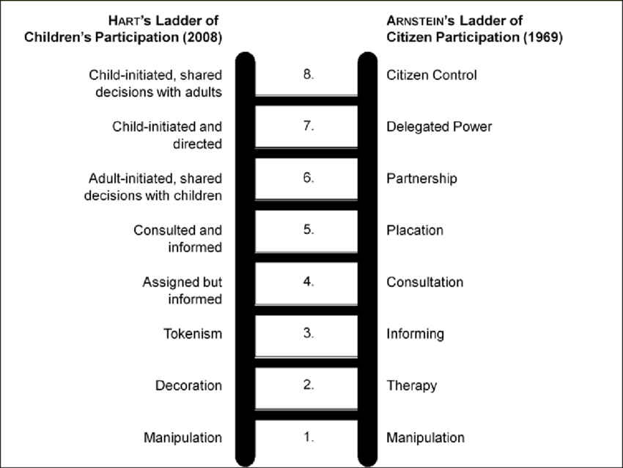

Slide 12
Directory

