Slide 1
Vocation

Slide 2
‘This [vocation] can be seen particularly in the Judeo-Christian tradition both in a range of Biblical narratives, through church history, and in more contemporary experiences where people have responded to a call to monastic life or ordained or lay ministry. In this way, vocation might be argued as being concerned with a particular ‘way of being’ embodiment or living, from which particular actions flow. Vocation can also be viewed as a process, of dedication - of being called from something to something else. Vocation is therefore concerned with who we are, who we will become, and the processes of formation that characterise that journey’ (adapted from (Bright, 2021:77)).

Slide 3
Vocation
Vocation is ‘an activity engaged in for the love of it by which others may be enriched or released: something you do as a freely chosen expression of your nature and energy, something that expresses the unique essence of yourself’ (Dewar, 1997:2).

Slide 4
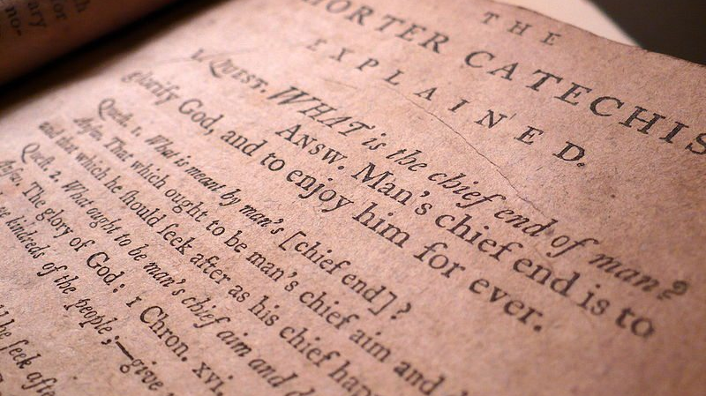
Notes:
A ‘generic call’ for us to be disciples, worshippers. But also calls to specific ministries identified throughout scripture and in particular those identified in 1 Cor. 12; 1 Cor 14; Ephesians 4 – different giftings, expressive of the one God.

Slide 5
Stories of God’s calling…

Slide 6
Which of these Biblical Stories of vocation stands out for you and why? What strikes you about the processes of calling and ministry in Biblical accounts?

Slide 7
Sharing, listening to and prayerfully speaking into our stories of vocation.

Slide 8
What about you?
What is your deepest gladness?
What is the world’s deepest hunger from your unique worldview?

Slide 9
Working through
What’s your own (vocational) story?
How has God called you?
What is your understanding of what God has called you to at this point in your journey?
At this point in your vocational exploration, what do you believe/feel God might be calling you towards?
What are the joys and challenges you experience in testing and working out that sense of vocation?
In what areas of your life/vocation do you feel most challenged to grow in?
How might you creatively represent that unfolding sense of and outworking of vocation?

Slide 10
Praying for each other, listening to what God might be saying – discern ‘prophecy’ (1 Corinthians 14:29).

Slide 11
(Solitude)? Time alone, quietly, noisily, creatively with God to connect in and check out.

Slide 12
Organise PDP meetings (Tuesday and Wednesday next week, Teams)

Slide 13
The first-year portfolio
A space to ‘evidence’, give account for and voice to your practice.
A place to develop reflection in drawing together practice, theology and theory.
A space for others to speak into your practice, allowing you to learn and develop further.
A space to consider how different strands of your practice and development become an integrated tapestry.
A space to be challenged, to challenge yourself and to celebrate what God is doing through you.
A space to set targets
A space to get creative.

Slide 14
Graham and Ward (2019:1)

Slide 15
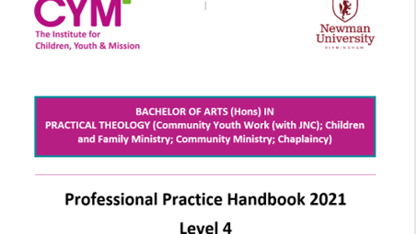

Slide 16
Thoughts, questions, reflections on the day…

