Slide 1
Professional Formation Group
A space to reflect, vision and grow.
Year 2 January, 2022.​

Slide 2
PFG
Proposed Structure:
Campus Committee
Halfway there!
Alternative Practices
Portfolio Tasks
Open Session
Individual Tutorials

Slide 3
Campus Committee
Notes:
News about Esther
Campus Committee Action Points - Apr 2022.docx

Slide 4
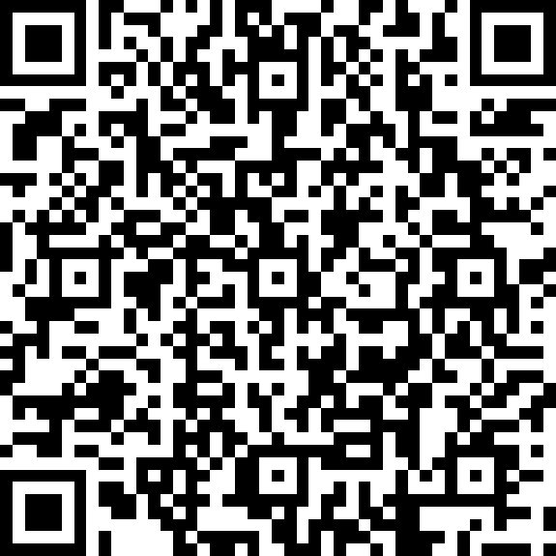
Campus Committee
If you’ve not completed the online survey, please do it now.
Notes:
Notes to staff:
The QR code is hyperlinked to the MS Form that we use to take notes.
https://forms.office.com/e/EjWSLvrPkc

Slide 5
You said last time… | We did…
The portfolio submission process is unclear | We think this was better in the summer – are we right?
Modules CYU403 and CYU404 are similar and there is no theology module in the summer term – could that be improved? | We can’t change the order, but tutors of both modules have met together to discuss content.
In CYM404 could we learn about how teaching was done in scripture? | Yes – Graham will be including this in 2023
It’s still difficult to find online resources | We understand – we will continue to provide training on this and model examples in class.
Sometimes the information on pre-reading or prep tasks comes too late. | Sorry – staff have been reminded.
Newman have changed their email system and messages are not being forwarded | We asked and it’s not possible to change this. Students and staff need to check Newman email account regularly. We taught students how to add Newman emails to Outlook or phone/tablets.

Slide 6
Transitions
HE roles and expectations
Learning and teaching: connections and gaps
Growing as a student and practitioner
Growing autonomy
Perspective: pushing for ‘the best’
Who am I honouring How much am I honouring?
Asking myself: ‘Where am I at?’; ‘What do I need and want here’? How do I ensure I get that?
‘Opening the box’ and going beyond.
Thoughts and feelings: challenges and discussions?

Slide 7
Alternative Practices
What makes a good alternative practice?
Sufficiently alternative experience
Stretch and challenge
Opportunity to demonstrate competence
Pragmatics and practicalities
Thoughts/explorations?

Slide 8
Alternative Practices
Scope out options – engage your Practice Tutor in planning
Approach organisations – scope out learning opportunities against your developmental needs/stretch/meeting competences.
When matched, complete Alt. Practice proposal form. PT and PM to agree.
Negotiate learning agreement in line with Role Description
Three Way Meeting with PT/Alt. LM
Practice, learn, reflect
Evaluation including Alt. LM’s formal evaluation of your practice using assessment form.
See MyCYM for relevant documentation.

Slide 9
Exploring Competence 2: Leadership and Management
What do these ideas mean to you?
Connections and delineations?
Theologies, theories and practices (module learning)
What does this look like in the context of my organisation and own practice?
What room might I need to negotiate?

Slide 10
Competence 2: Leadership and Management
You need to be able to demonstrate the following knowledge, skills, attitude and theological engagement in a range of situations. Relevant theory and theological reflection should be integrated throughout.
a. Understand key theories and models relating to building relationships with people (For example: Carl Rogers, Richard Nelson, Erikson, Fowler, Kohlberg, Piaget, Westerhoff, Egan)
b. Develop an understanding of people and relationships from a theological perspective.
c. Build appropriate relationships of trust with people, colleagues and appropriate others.
d. Make effective use of supervision and course structures (e.g. raising issues with Practice Tutor and Line Manager, completing action points)
e. Implement good practice in relationships with people, including appropriate use of power, boundaries, confidentiality and referral.
f. Demonstrate effective communication, negotiation, listening and relationship skills.
g. Use a range of models of intervention within your practice (e.g. informal education, mentoring, advocacy, pastoral care, discipleship, accompanying) to support people’s change and growth.
h. Enable people to explore and make sense of their experiences, and plan and take action.
i. Demonstrate the necessary skills and strategies to manage behaviour – including developing positive environments and appropriate discipline.

Slide 11
Exploring the task
Approach the task with an imaginary – refining views on leadership and management drawn from CYU 503 Managing People and Projects.
Embed theological and theoretical learning as you cultivate it through engagement, practice and reflection. Be alive to transformations.
What does leadership look like, scripturally, professionally, as informal educators? How might these values shape your thinking and doing? Questions of typicality/typology and atypicality regarding leadership and management.
Opportunities/issues/concerns?

Slide 12
Exploring the task (Practice Handbook p.27ff)
Observation 1:
Deliver a training session or planning meeting with your team appropriate to your setting which your Practice Tutor will observe. You should discuss the session plan and evaluation with your Practice Tutor before and after the observation. You should include in your portfolio:
Session plan and evaluation
Materials used in the session
The observation report completed by your Practice Tutor
The second of three entries from your reflective diary, session recording log, blog or vlog exploring your practice and attitudes as an informal educator, promoting inclusion, equity and the valuing of diversity.
(Leading and managing as an informal educator).

Slide 13
What, then should we explore?

Slide 14
Tutorials

